Slide 1



Title
Human Resources Analysis Predict Attrition
Ana Filipa Gonçalves, 20222157
Cláudia Gomes, 20221615
Frederico Rodrigues, 20222159
João Silva, 20222190
Notes:
Hello, we are from bi4all consulting, and we are going to analyse human resources data from your company and give you some insigths about how to overcome attriction in your company.

Slide 2
Agenda
Context
Model
Analysis
Suggestions
Notes:
We have divided our presentation in the following topics:
- we will start with the context (by showing you the importance of attrition in the company and overall)
- then, the model (we will explain the predictive model that we created)
- then, analysis (Where we will share our results)
- then we will presemt several recommendations to overcome attrition)

Slide 3
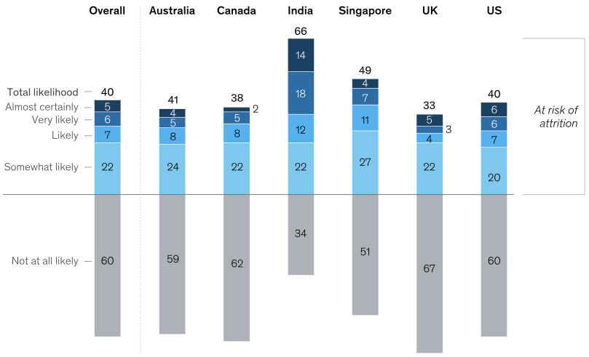
Is the Talent Crisis Global? 82% of Top Executives Say Yes!
According to McKinsey latest reports about Companies’s Attrition:
40% of workers globaly are considering leaving their jobs
Almost one-third of senior leaders cite finding talent as their most significant managerial challenge
82% of Fortune 500 executives belive their companies are failling to recruit highly talented individuals
A majority of people who quit their jobs are not returning to the industries they left, showing a significant level of industry-hopping
Notes:
So, starting with the context,
Why is attrition so important nowadays?
According to McKinsey latest reports, 40% of workers globaly are considering leaving their jobs. So its not a situation from a specific company or industry, it’s a global problem. Furthermore, almost one-third of senior leaders says finding talent as their most significant managerial challenge. So its clear that we have a problem here. We have a consider amount of employees leaving our companies and we have the big leaders saying that its really difficult to substitute these employees.

Slide 4
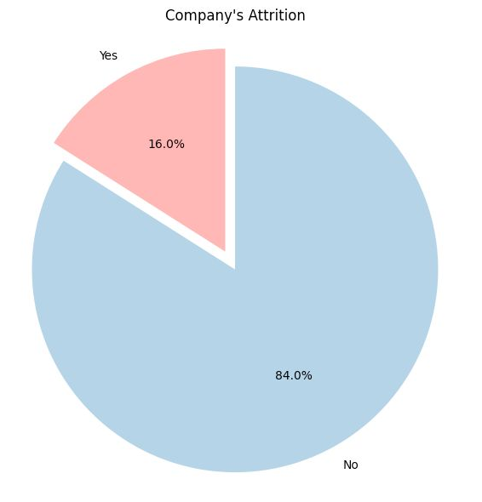
Beyond Perception: The Power of Predictive Analytics in Talent Management
“We find that statistical data is much more effective and actionable than perception analysis, because there's all sorts of bias in asking people questions,” - Matthew Stevenson, partner and co-leader of Mercer’s Workforce Strategy & Analytics group
Key benefits:
Data-informed Engagement Strategies
Improved Retention
Orgazinational Change
Notes:
This is why is so important to analyse the data that we have from employees in order to predict and avoid losing the talent that we already have.
We find this way to be much more effective and actionable to overcome attriction.
Being more specific, about your company, at this moment your company has 16% of attrition and our goal is to reduce this number., by identifying who’s leaving your company and by giving you actionable recommendations.

Slide 5
Agenda
Context
Model
Analysis
Suggestions
Notes:
We wlil now give a brief presentation of the predictive model we implemented.

Slide 6
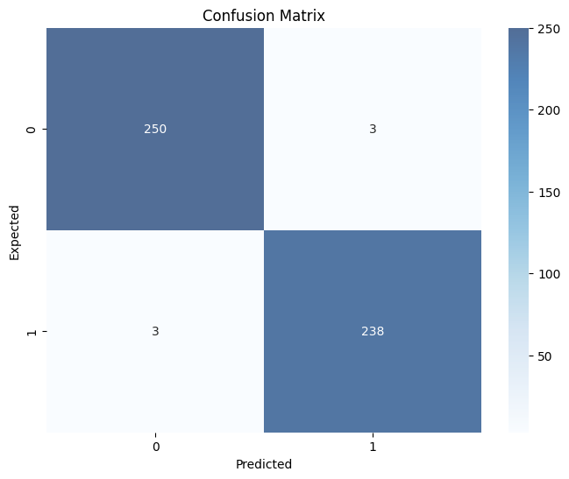
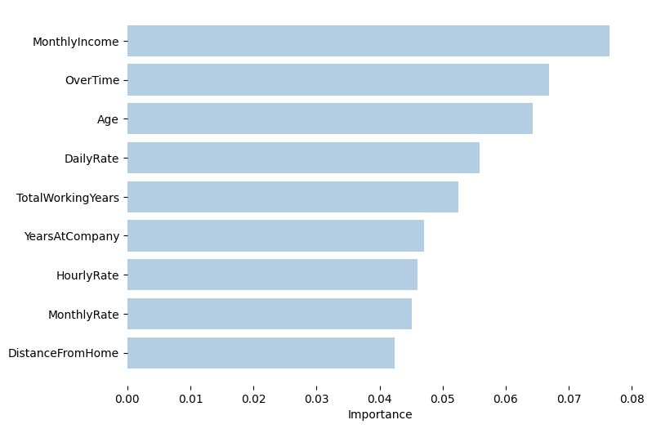
Leveraging Data and Analytics for Enhanced Outcomes
We conducted rigorous data pre-processing, dropping non-essential features and utilizing the RandomOverSampler to address imbalanced data. Once the dataset was split, we explored several models. Among Logistic Regression, Decision Trees, and RandomForest, the RandomForest model stood out post hyperparameter tuning. Impressively, it achieved a consistent 0.99 score across key metrics, including Precision and Recall.
Notes:
1 min – João
We undertook a rigorous data pre-processing phase, and tested several machine learning models. RandomForest was the model that stood out.
Let me direct your attention to the charts. Our model achieved an impressive consistent scores. The confusion matrix provides a visual representation the performance, with minimal False Positives and False Negatives.
On the right we’ve showcased the top feature importances for our model. You can see that there are a couple of features related with wages. We also have Overtime, Age, TotalWorkingYears and DistanceFromHome

Slide 7
Agenda
Context
Model
Analysis
Suggestions
Notes:
We will now further explore “why are these features so important?”

Slide 8
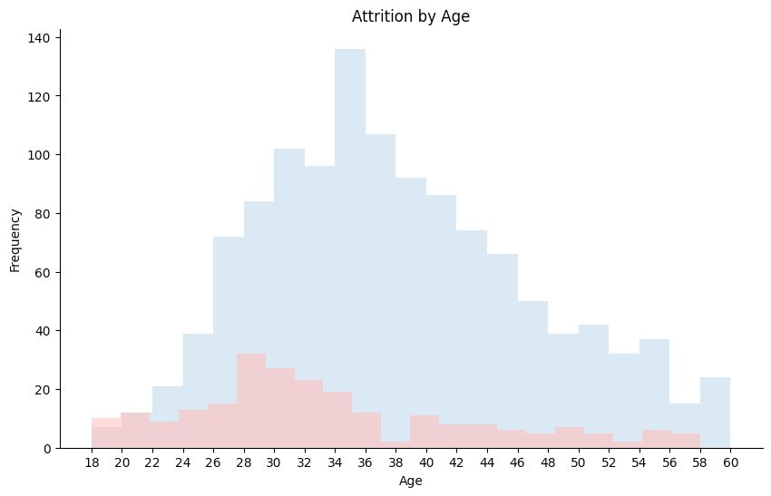
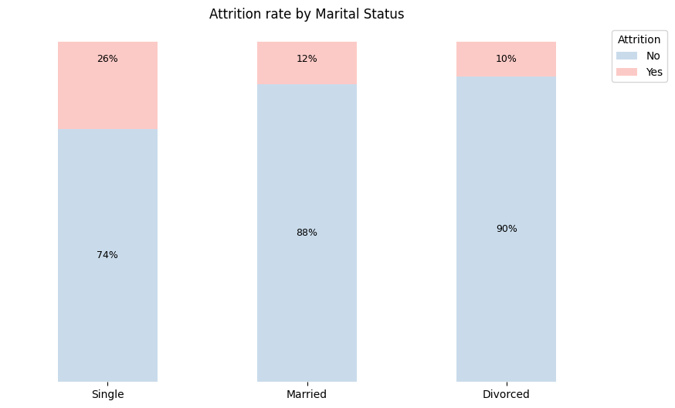
Unmasking the Profiles: Who's Really Leaving Your Company?
Younger and Single employees tend to have higher percentage of attrition
Notes:
Let's first focus on the chart to the left, which showcases attrition by age. As we can see younger employees are more likely to leave. We can actually see that between the ages of 18 and 22 we are losing as much employees as we retain.
Moving on to the right, we've categorized attrition rates based on marital status. Single employees have the highest attrition percentage.

Slide 9
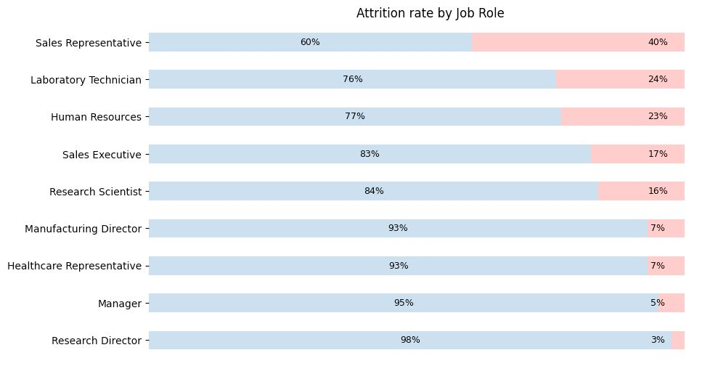
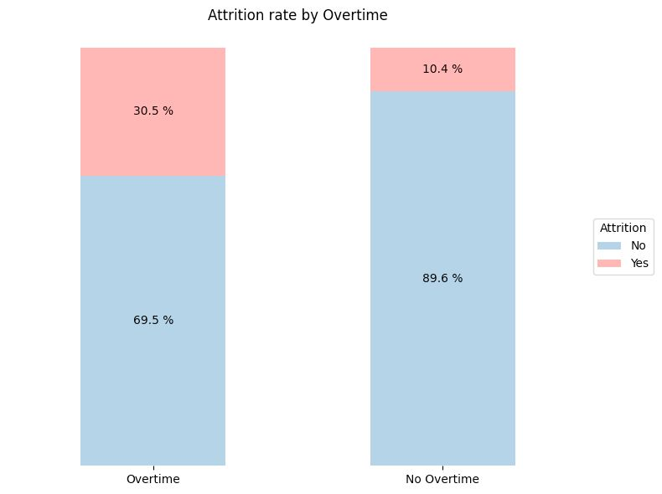
Unmasking the Profiles: Who's Really Leaving Your Company?
Sales representatives have the highest attrition rate
Employees that work overtime tend to have higher percentage of attrition
Notes:
As we continue to dive deeper into understanding the attrition patterns within your company, this slide sheds light on two more significant areas: job roles and overtime.”
On the left, you can observe the attrition rates segmented by job roles. Sales Representatives have the highest attrition rate, reaching the 40% mark. But note that Sales Executive, Human Resources, Laboratory Techinician are all above the Company attrition average of 16%
Shifting our attention to the right, the data is quite revealing. Employees who work Overtime have an attrition rate of 30.5%. In contrast, those who do Not work Overtime have a much lower attrition rate of 10.4%. This suggests that while overtime might be necessary in some scenarios, it could be contributing to burnout or dissatisfaction among our workforce.

Slide 10
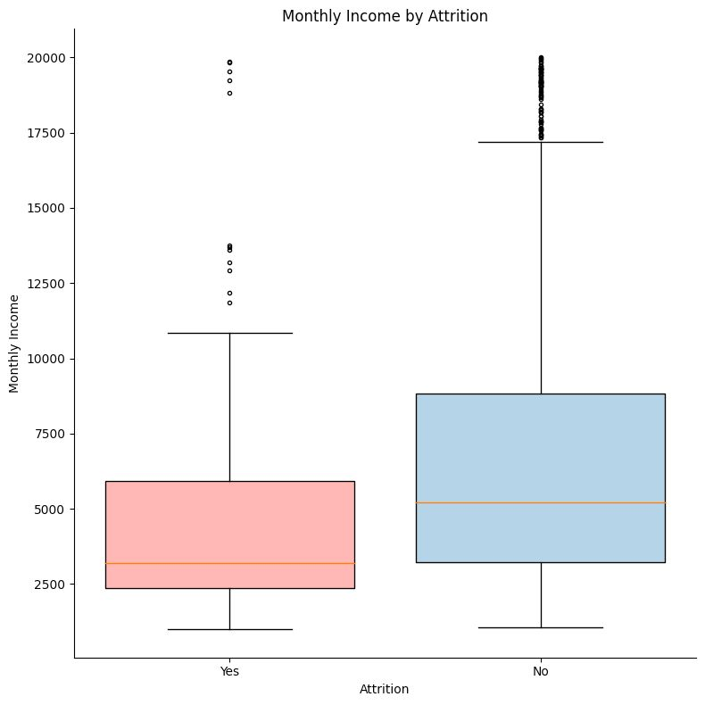
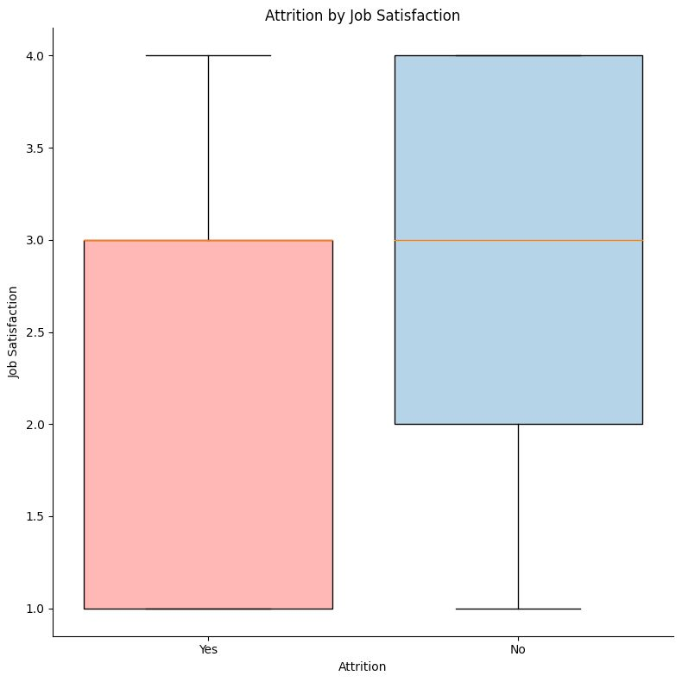
Unmasking the Profiles: Who's Really Leaving Your Company?
Employees who have attrition have a mean monthly Income significantly lower than the employees who do not have attrition
The minimum job satisfaction for a employees not have attrition seems to be 2.0.
Notes:
Continuing our exploration into the reasons behind attrition, on the left, we see a comparison of the monthly incomes and Attrition. It's evident that those who leave the company have a significantly lower average monthly income than those who stay. This underscores the importance of competitive compensation in retaining talent.
Moving right, there is a distinct low variability on those who left the company. This threshold may be a red flag, indicating a higher risk of attrition.

Slide 11
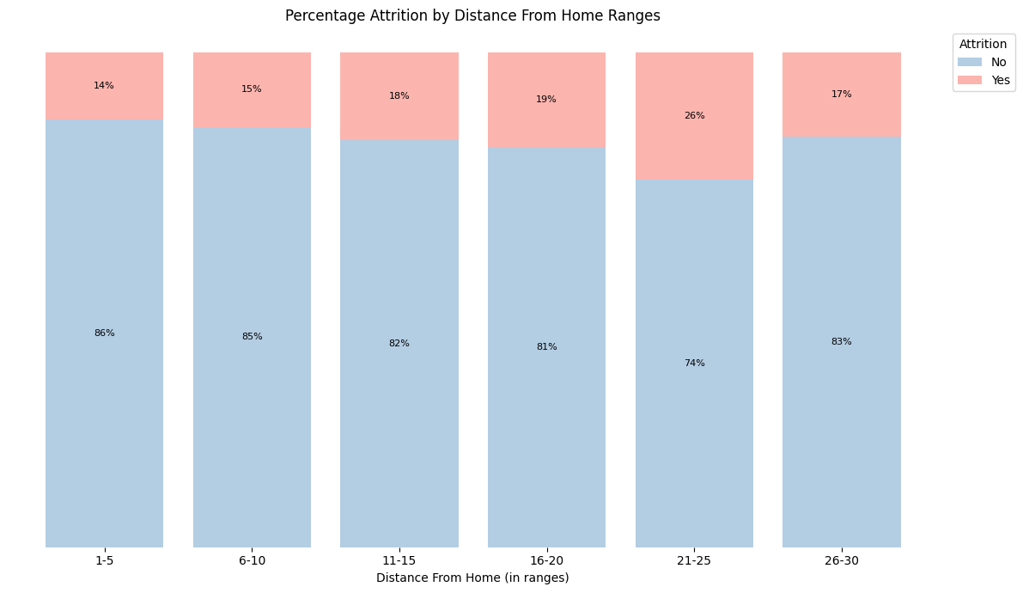
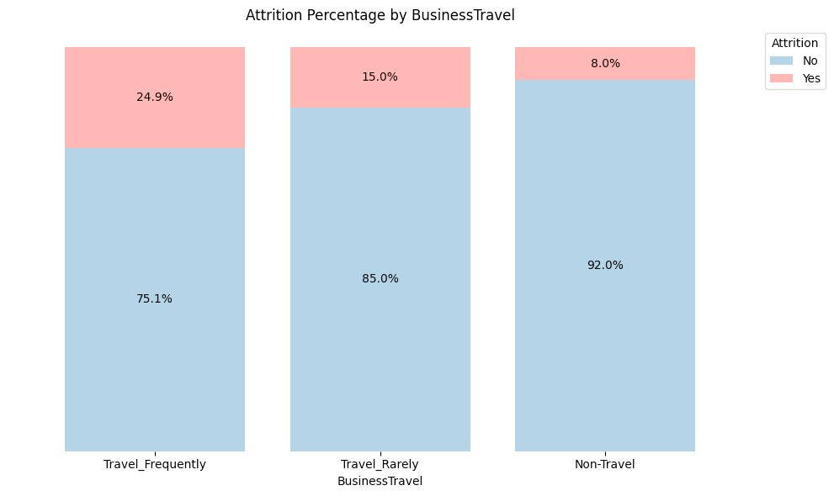
Unmasking the Profiles: Who's Really Leaving Your Company?
As distance from home increases, the attrition rate also increases.
Employees that travel the most for work have the highest attrition levels.
Notes:
On the first graph, we can see that as distance from home increases, the attrition rate also goes up. There’s a clear uptrend until the 21-25 range, meaning that employees who live closer to their work places are less likely to quit their jobs.
The second graph also shows a very clear trend, which is employees who travel the most for work, also have higher attrition levels. Those who rarely travel have intermediate attrition rates, and those who don’t travel at all have the lowest attrition rates.

Slide 12
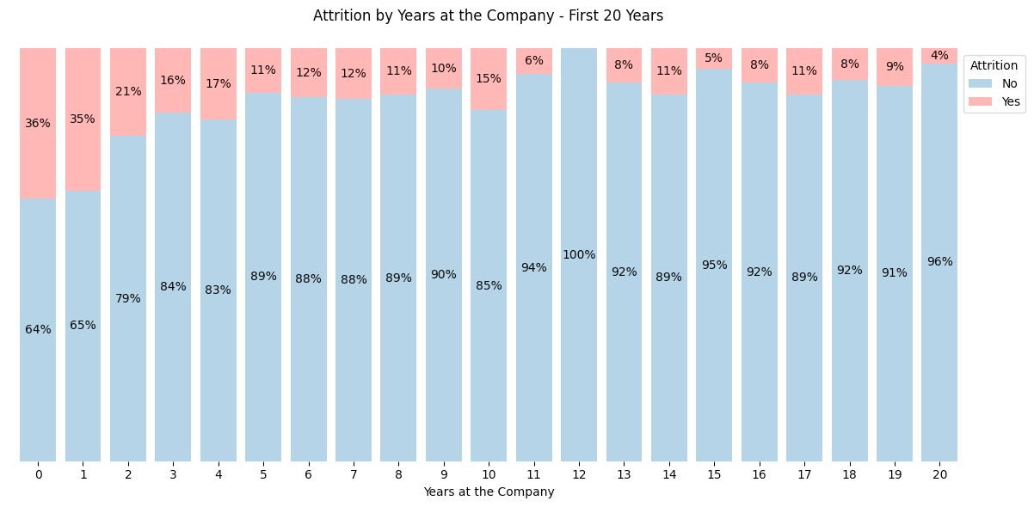
Unmasking the Profiles: Who's Really Leaving Your Company?
New employees tend to have higher percentage of attrition, specially up until 2 years working in the company
Notes:
This plot is very interesting because it shows that new employees are more likely to quit their jobs, when comparing to employees that have been working in the company for more than a couple of years. This trend is particularly steeper in the first 2 years working in the company, with attrition rates over 20%, and then it tends to level off.

Slide 13
Agenda
Context
Model
Analysis
Suggestions

Slide 14

Overtime can lead to burnout and dissatisfaction
Implement flexible work arrangements to maintain a healthy work-life balance, such as remote work and flexible clock in and out hours
Hire additional staff or redistribute workloads to reduce the need for overtime
Have a pre-determined high rate to pay in case of overtime hours
Notes:
Implement flexible work arrangements to improve a healthy work-life balance, such as remote work and flexible working hours.
Redistribute workloads to reduce the need of overtime, or ultimately hire additional staff.
Establish beforehand the rate for additional working hour, and pay them accordingly.

Slide 15

Empowering Employees: Climbing the Compensation Ladder
Make sure salaries are according to the industry benchmarks
Performance incentives and bonuses
Clear career path and salary revision
Additional benefits:
Retirement savings account
Medical Insurance
Education incentives
Child care contributions
Notes:
Assure that salaries are according to the industry benchmarks
Offer performance incentives and bonus. Define clear targets either it’s monthly, quarterly or yearly, and compensate employees who reach their goals.
Show a clear career path and how employees can grow within the company. Make sure there’s a salary revision when a promotion occurs.
Provide additional benefits such as retirement savings accounts, medical insurance, education incentives and child care bonuses.

Slide 16

Enhancing Employee Retention and Satisfaction
Implement mentorship and career development programs
Promote a culture of ongoing learning
Provide career advancement opportunities to retain experienced workers
Rewards for a certain number of worked years
Act preventively they reach the average age of leaving (34 years old), by conducting regular satisfaction surveys
Notes:
40s - Filipa
Flexible Work Arrangements: Offer remote work options or flexible schedules to reduce commuting hassles.
Transportation Assistance: Provide company shuttles or transit subsidies to ease the burden of commuting.
Relocation Assistance: Offer support for employees willing to move closer to the workplace.
Satellite Offices: Establish smaller offices closer to where clusters of employees live.
Technology Investments: Enhance virtual communication tools to support effective remote working.
Regular Surveys: Conduct surveys to understand commuting challenges and continuously improve support measures.

Slide 17

Initiatives for Employee Comfort and Connectivity in the Modern Workplace
Provide transportation assistance, such as company shuttles or transit subsidies
Satellite Offices close to where clusters of employees live
Technology Investments to enhance virtual communication tools, in order to support effective remote working
Regular Exit Surveys
Notes:
40s - Filipa
Flexible Work Arrangements: Offer remote work options or flexible schedules to reduce commuting hassles.
Transportation Assistance: Provide company shuttles or transit subsidies to ease the burden of commuting.
Relocation Assistance: Offer support for employees willing to move closer to the workplace.
Satellite Offices: Establish smaller offices closer to where clusters of employees live.
Technology Investments: Enhance virtual communication tools to support effective remote working.
Regular Surveys: Conduct surveys to understand commuting challenges and continuously improve support measures.

Slide 18
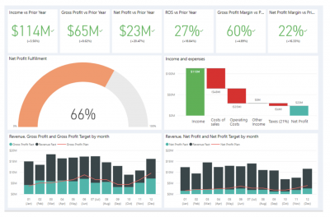
Integrating Predictive Attrition Model into HR Dashboard
Empower HR with actionable insights to proactively address potential employee attrition.
Real-Time Monitoring: Track and monitor employees predicted at risk of attrition.
Prioritization: Focus on high-risk individuals for retention interventions.
Trends & Analysis: Visualize attrition patterns over time to inform strategic HR decisions.
Custom Alerts: Set notifications for flagged employees to take timely action.
COMING SOON
Notes:
40s - Filipa

Slide 19
The End
Questions?

